Slide 1
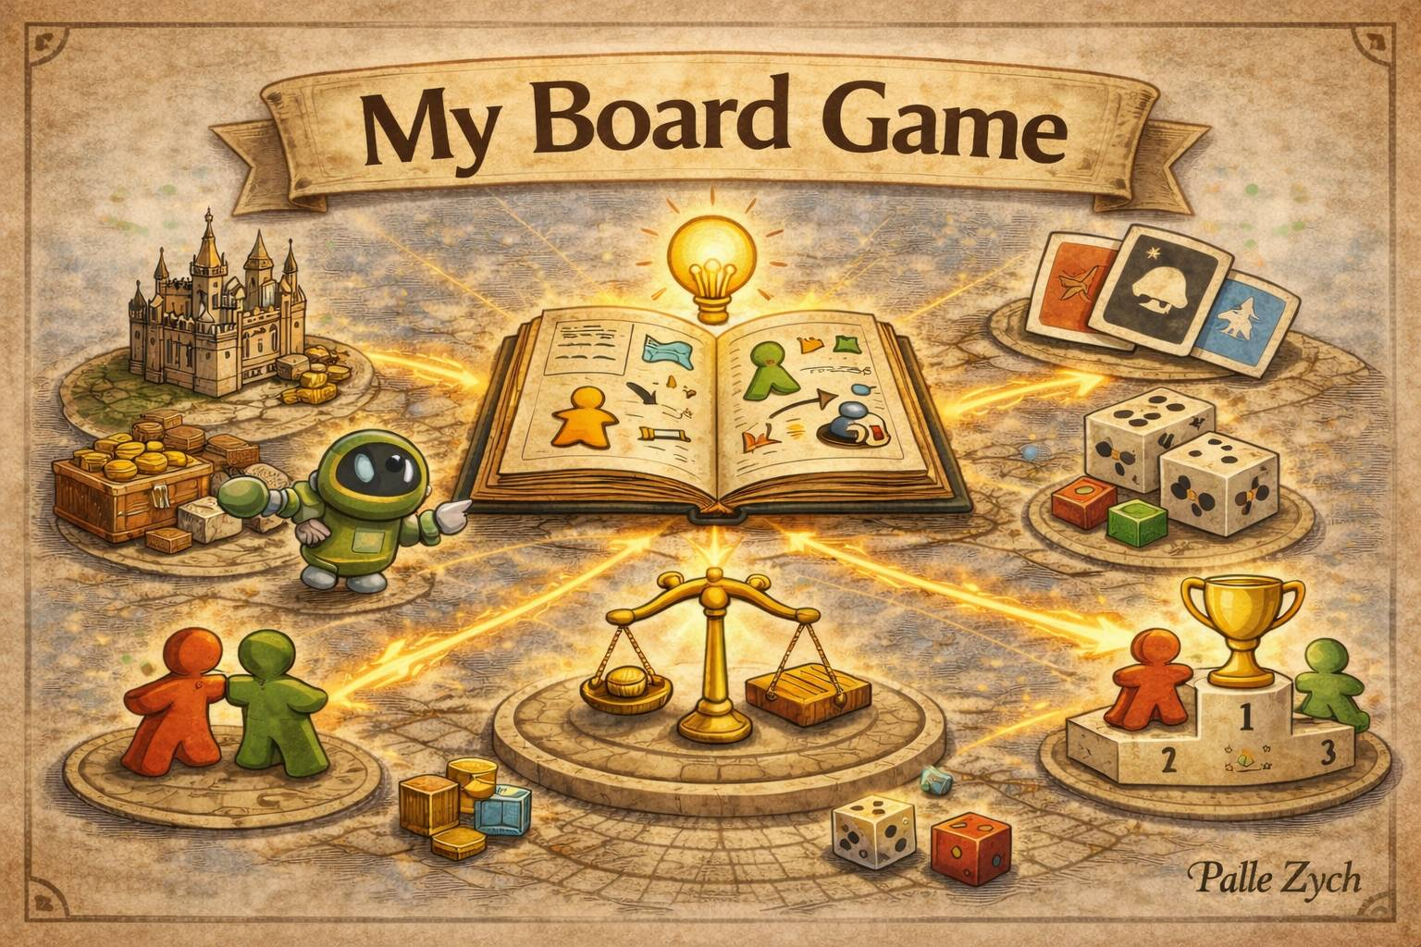

Slide 2
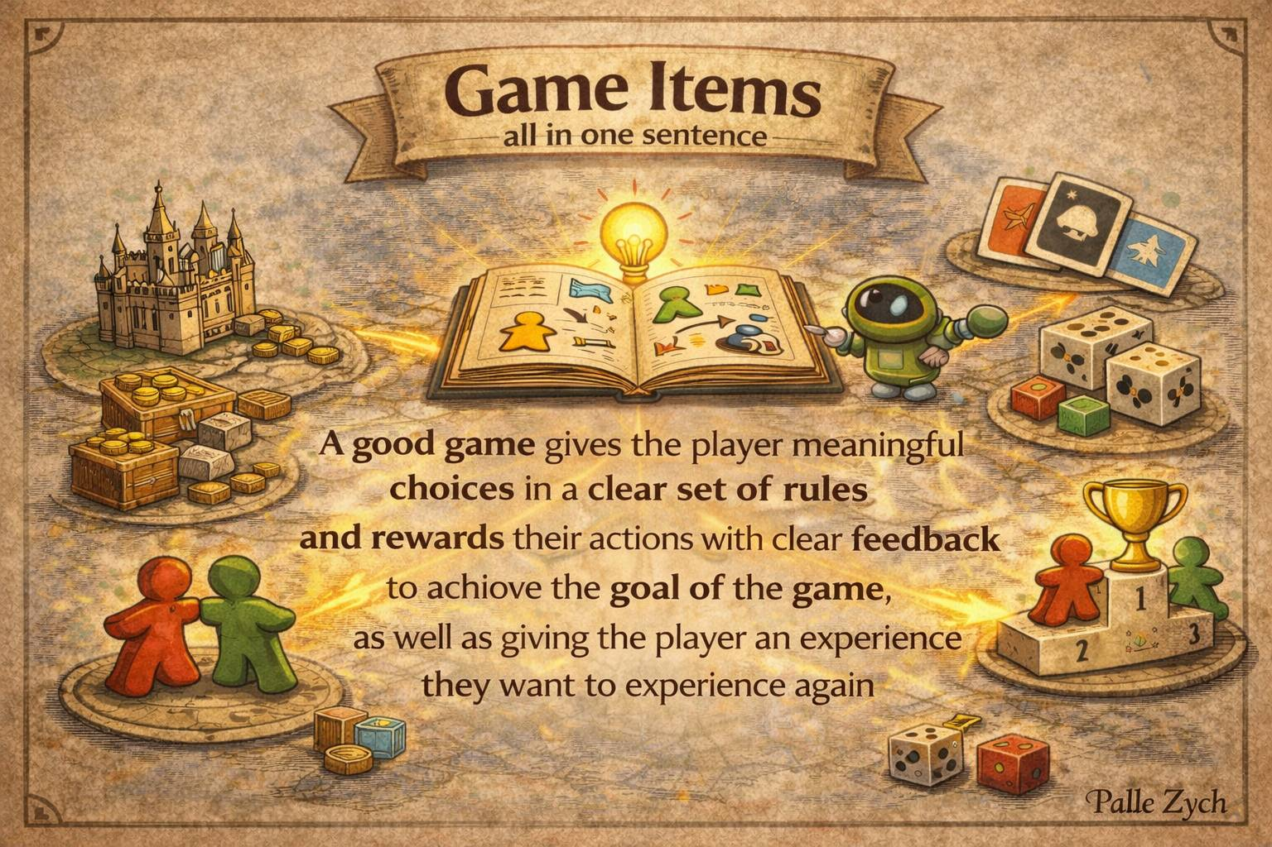

Slide 3
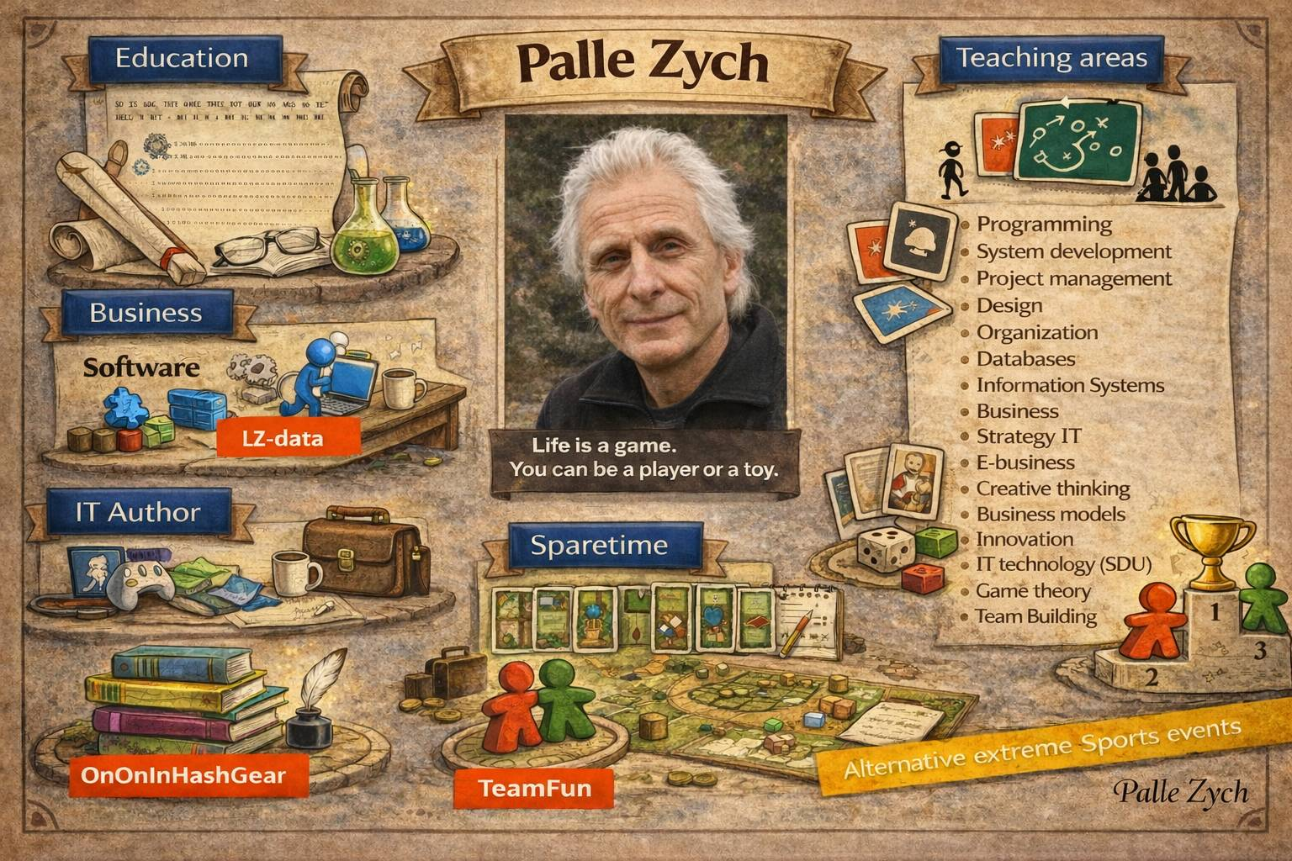




Who am I
Business Concept and Strategy Developer Copenhagen Univercity, SDU (extern lecturer), IT-univercity (social media)
Software and IT Developer - Copenhagen University, IT-university
OnOn HashGear
Forlaget /uvlib

Slide 4
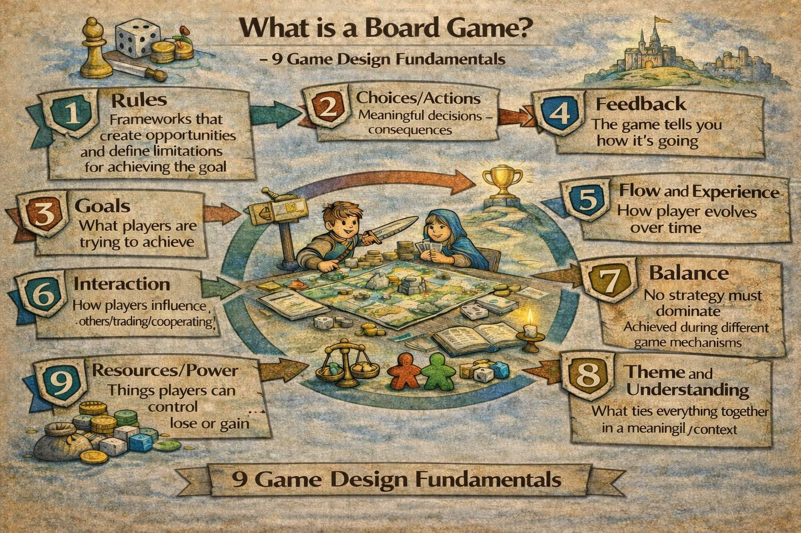
Together these elements are connected and create a board game

Slide 5
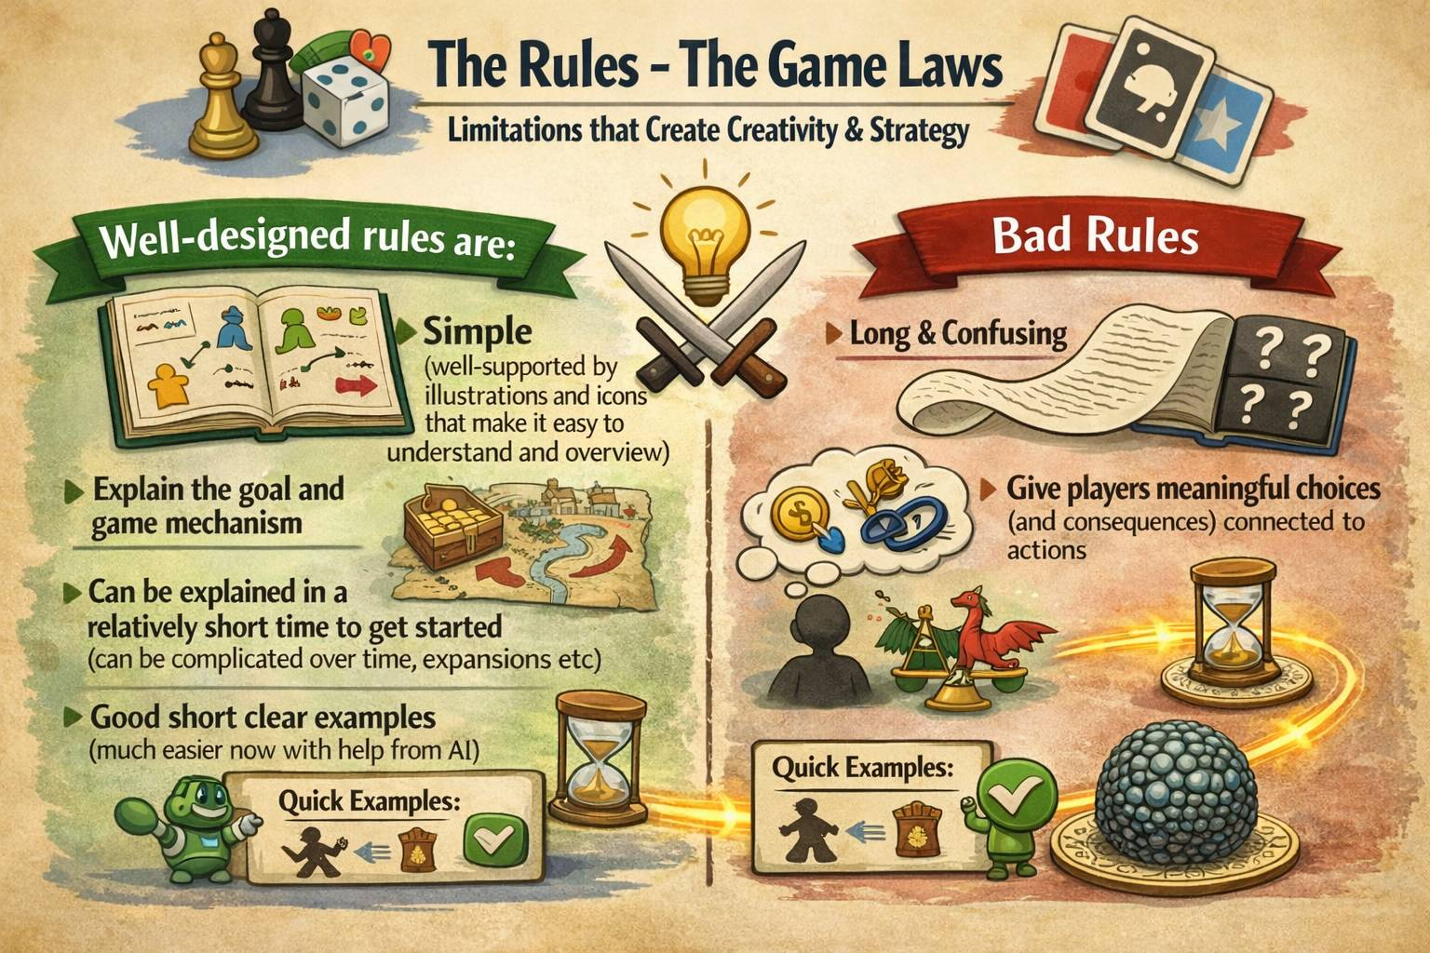
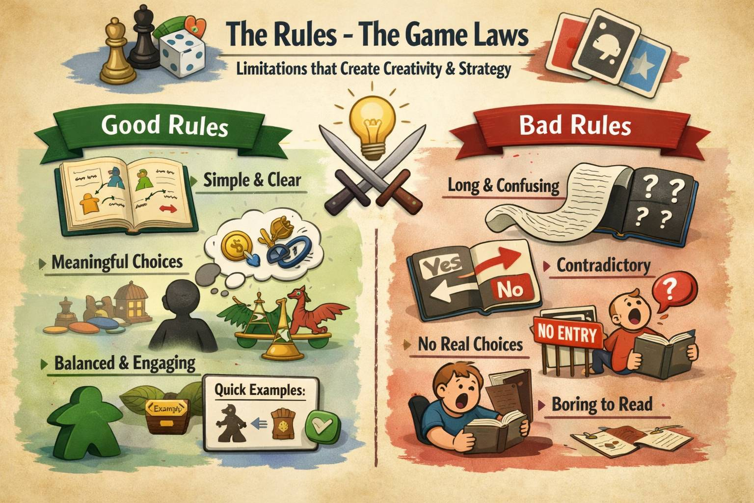

Slide 6
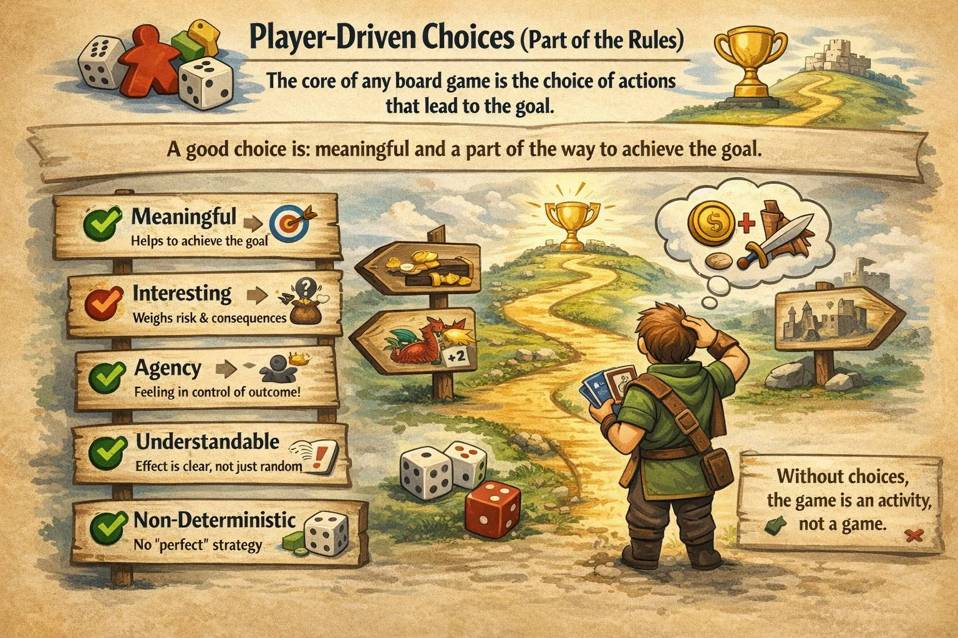

Slide 7
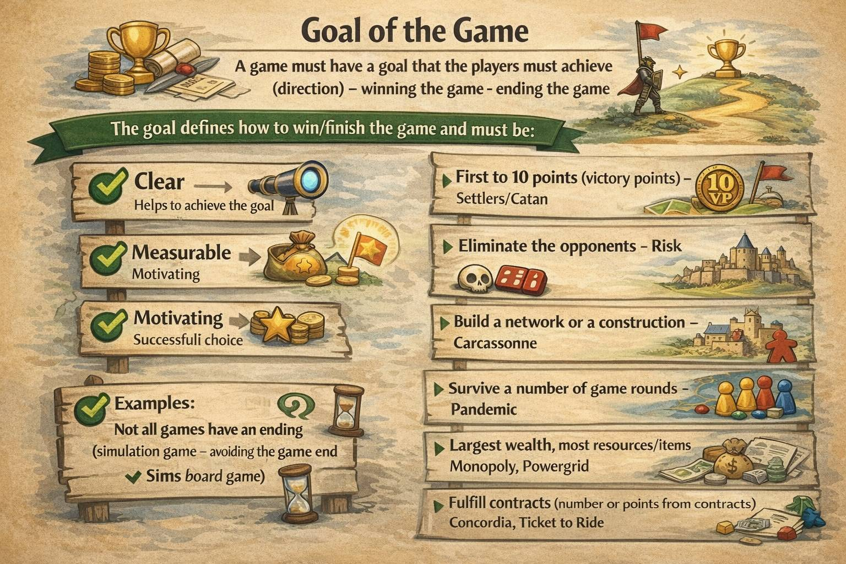

Slide 8
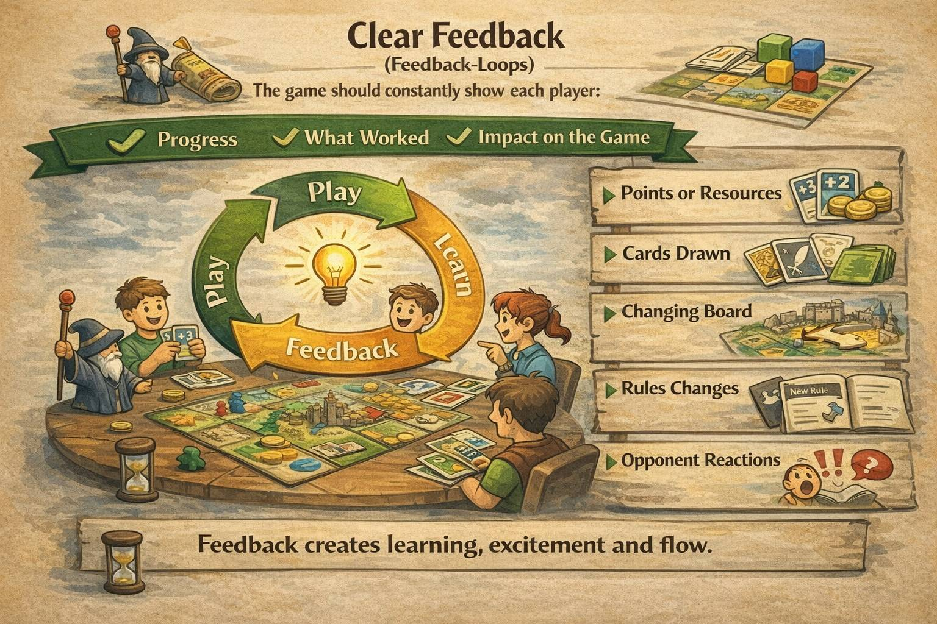

Slide 9
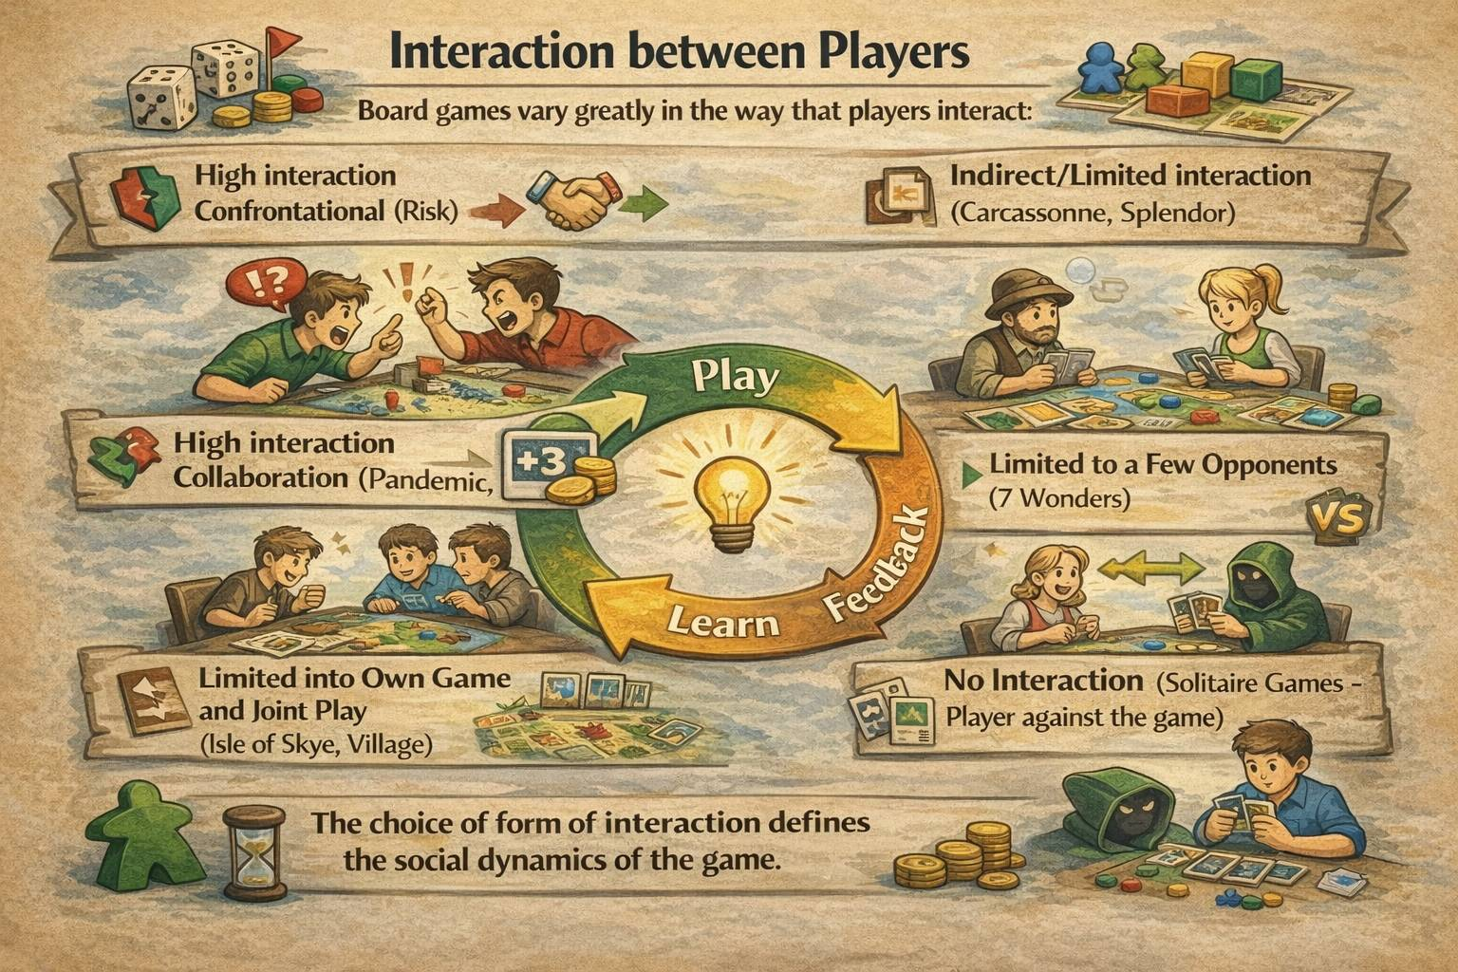

Slide 10
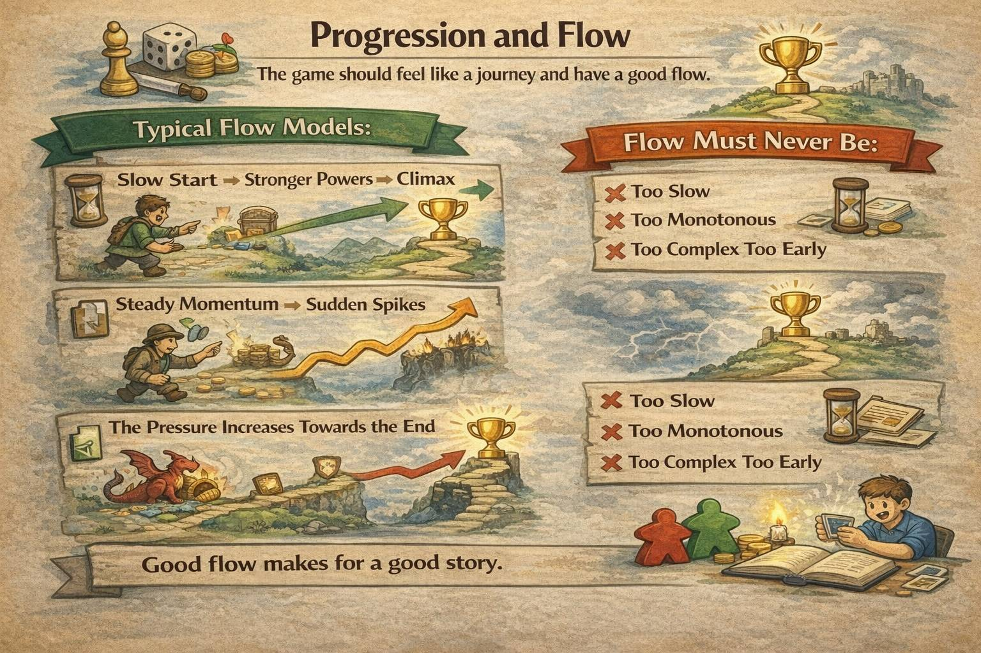

Slide 11
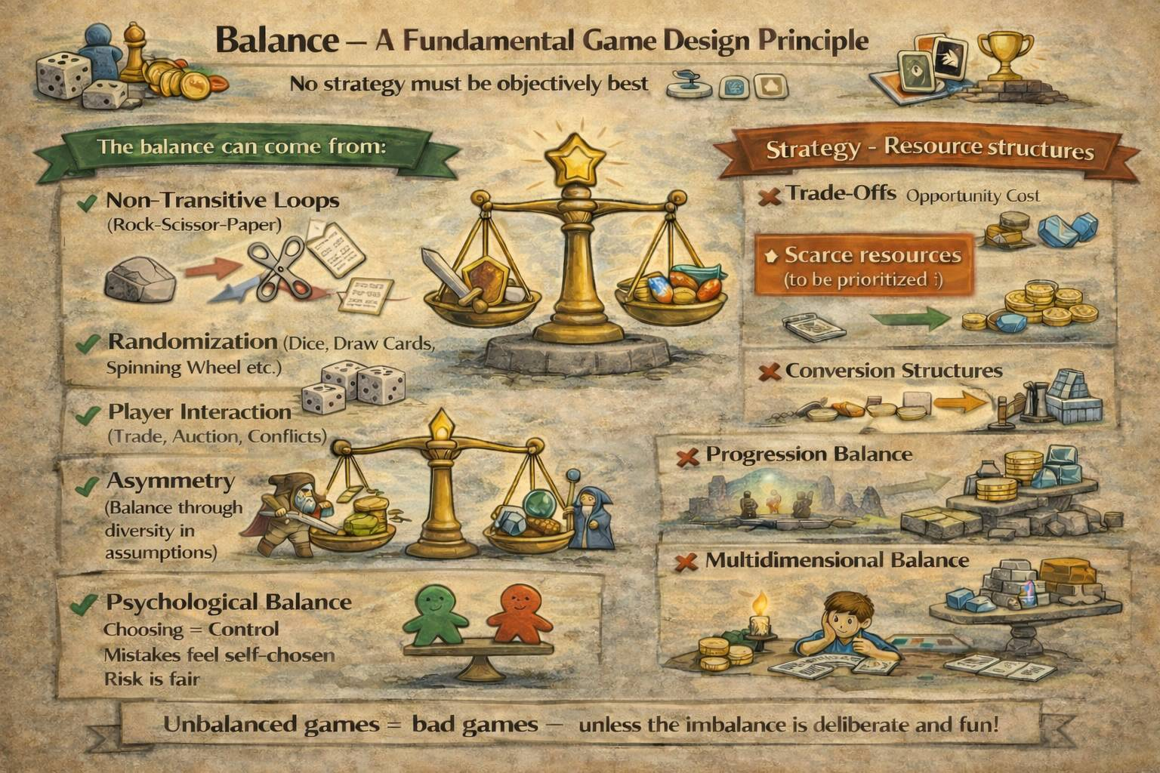

Slide 12
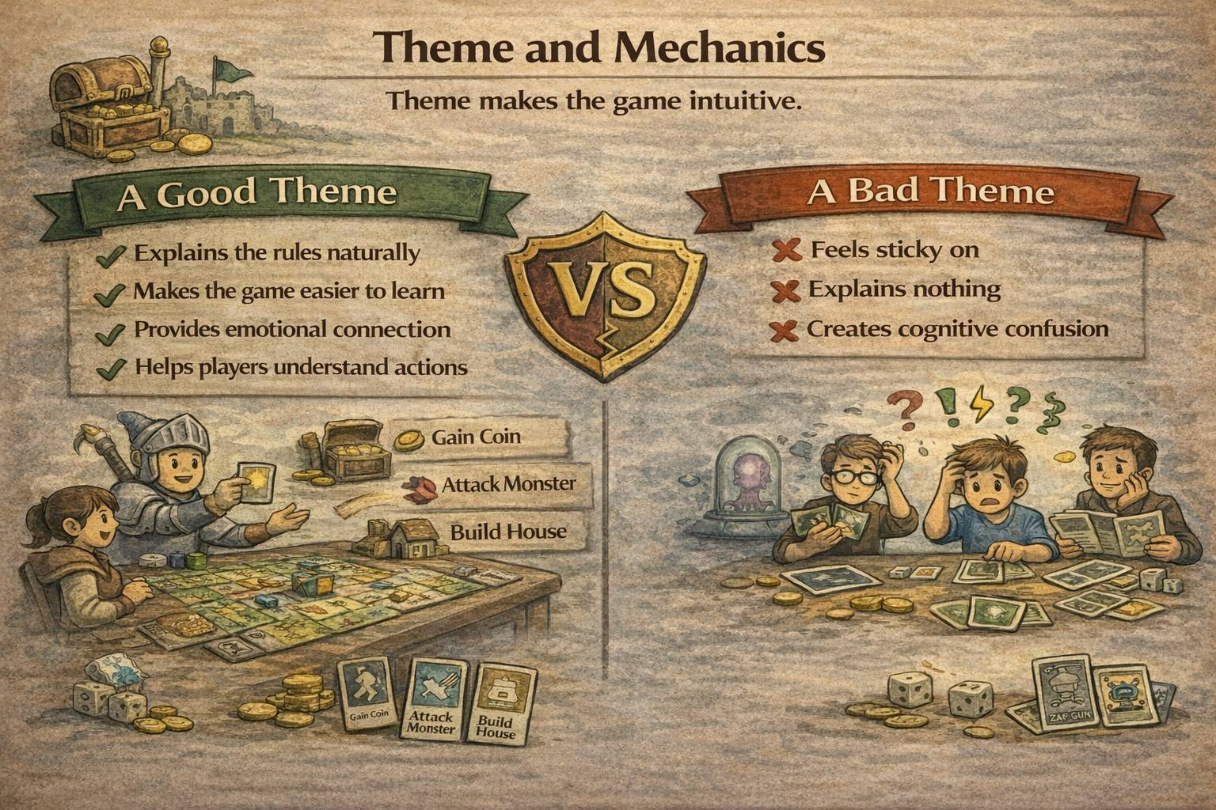

Slide 13
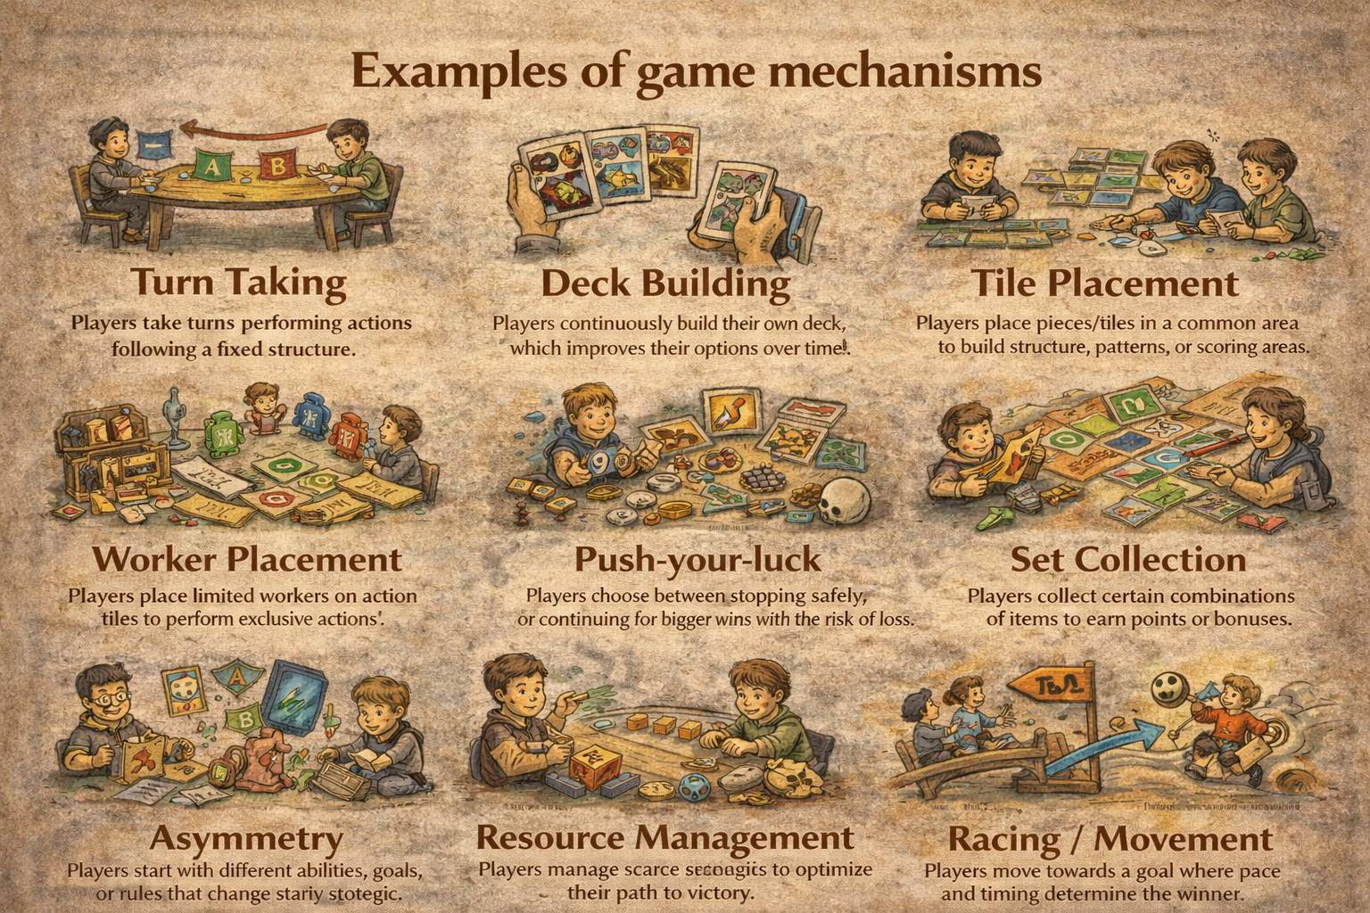

Slide 14
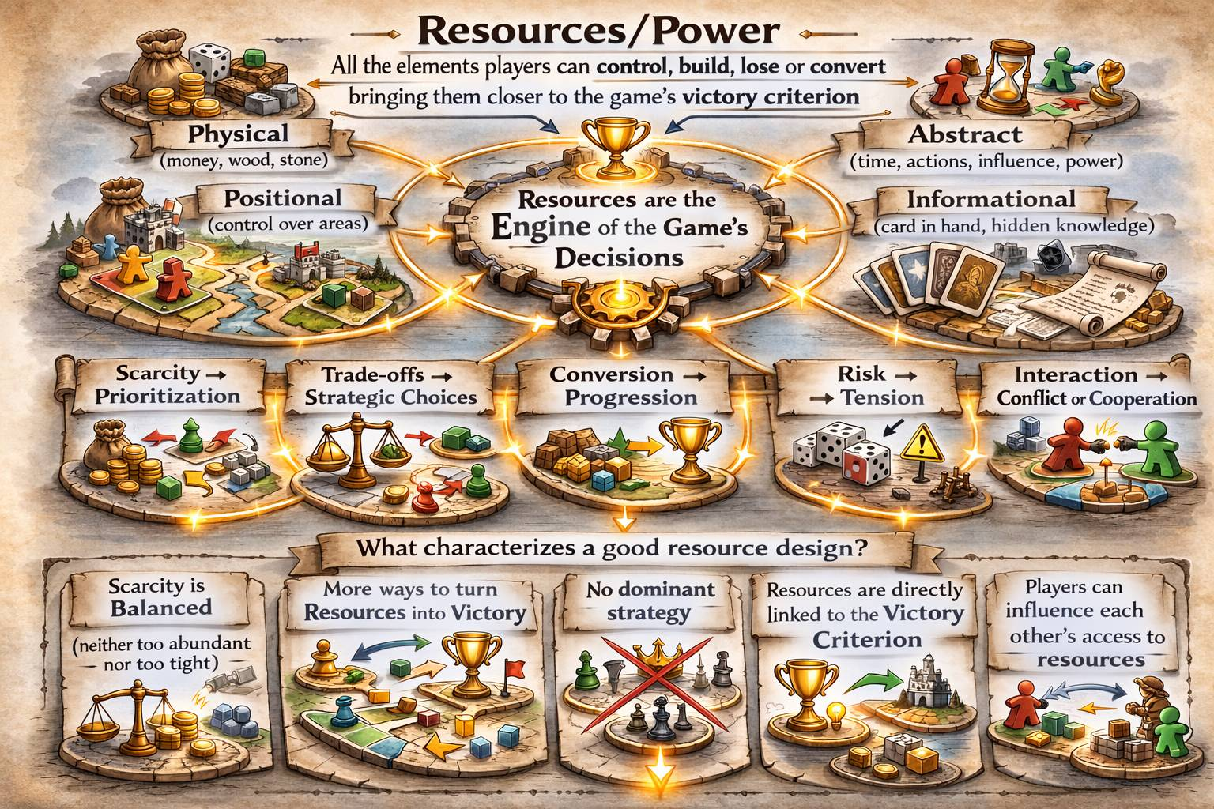

Slide 15
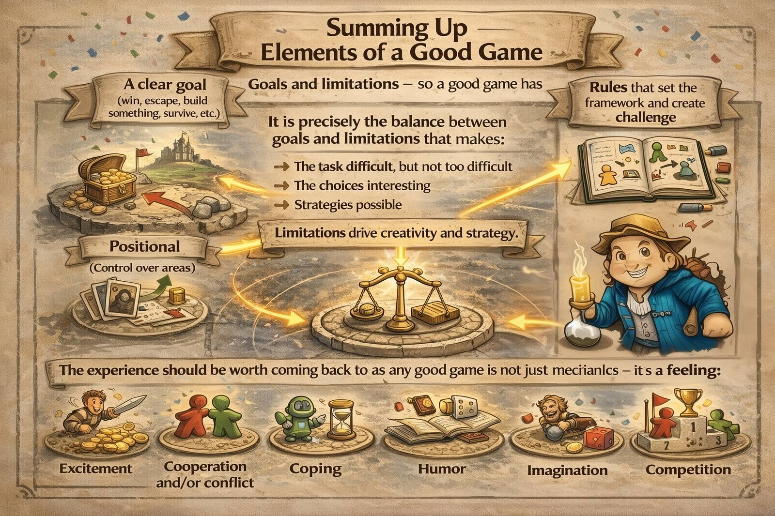

Slide 16
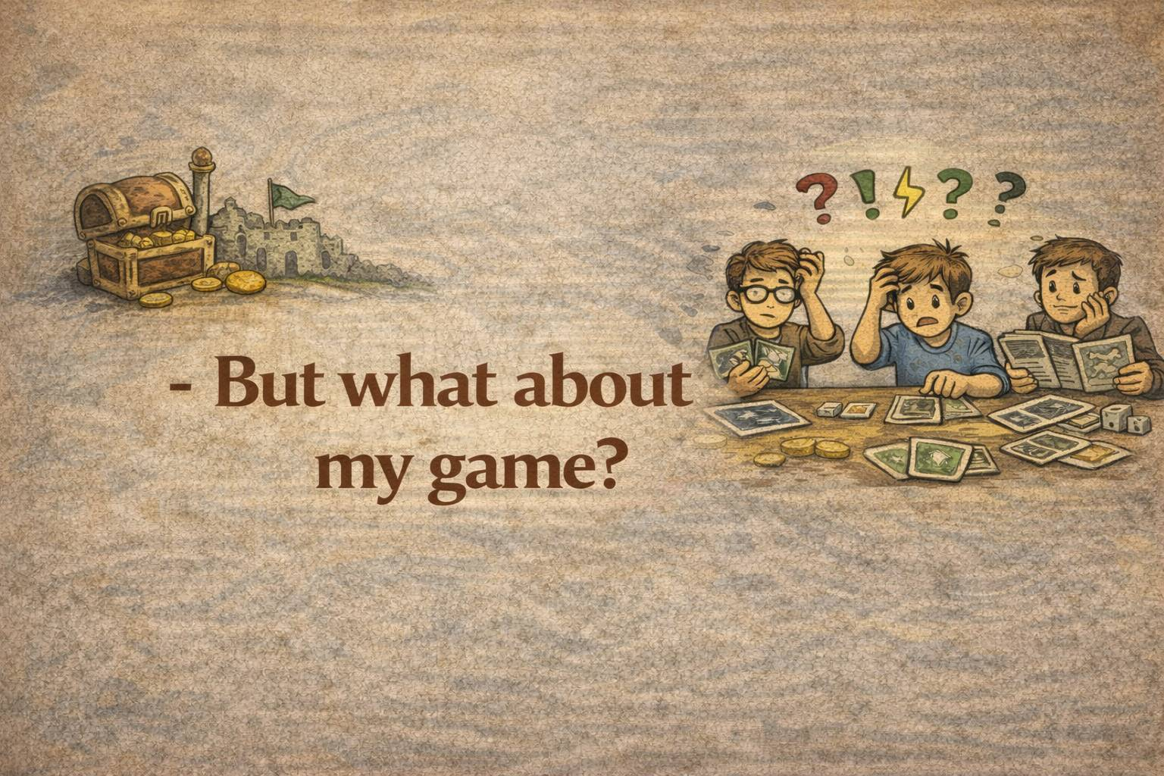

Slide 17
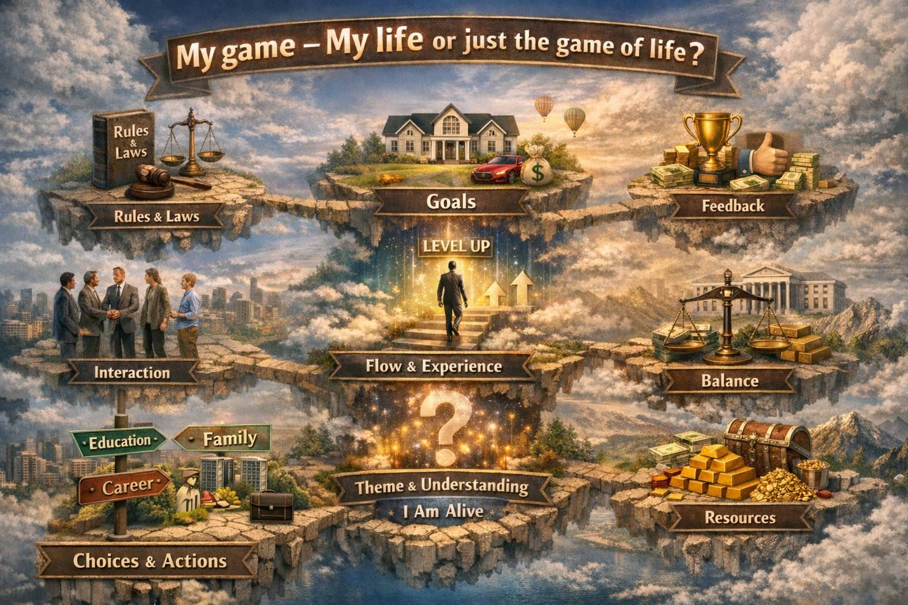
what I am trying to achieve in my life (power, money, house – fulfilling Maslows needs pyramid
my experience, tells me how it's going (feedback for the decisions I made like receiving awards, money, increasing power etc)
  Laws, ethic, behavior, culkture society
  (different depending on the context)
how I behave together with other people during conflicts/trading/cooperating, helping
the feeling the life gives (especially progress and results reaching sub goals)
complex (not my focus, but important for the society (goverments try to make conditions fair as long you are following the rules
what ties everything together in a meaningful context
meaningful decisions (all what I am doing every day for achieving my goals
All the things I really want and fighting for (winning my game of life

Slide 18
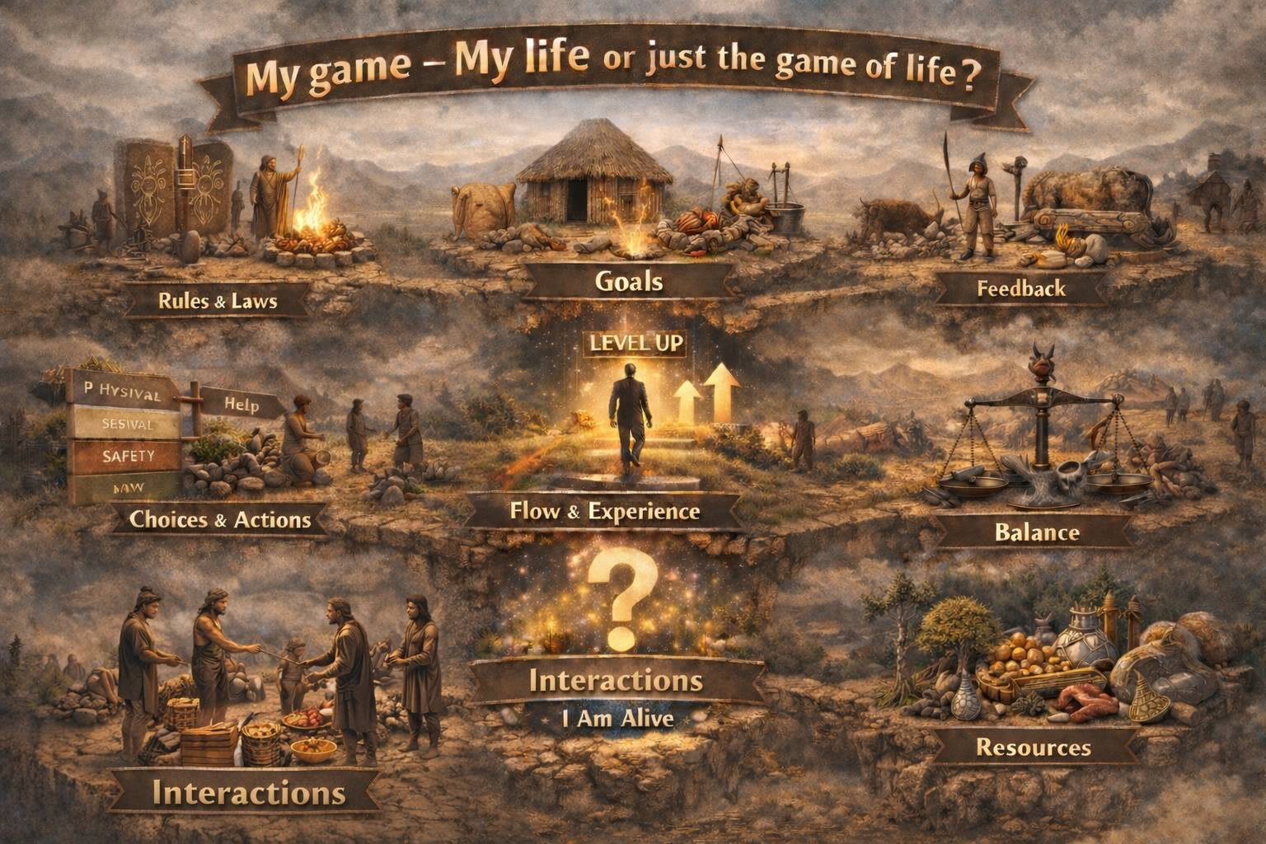


Slide 19
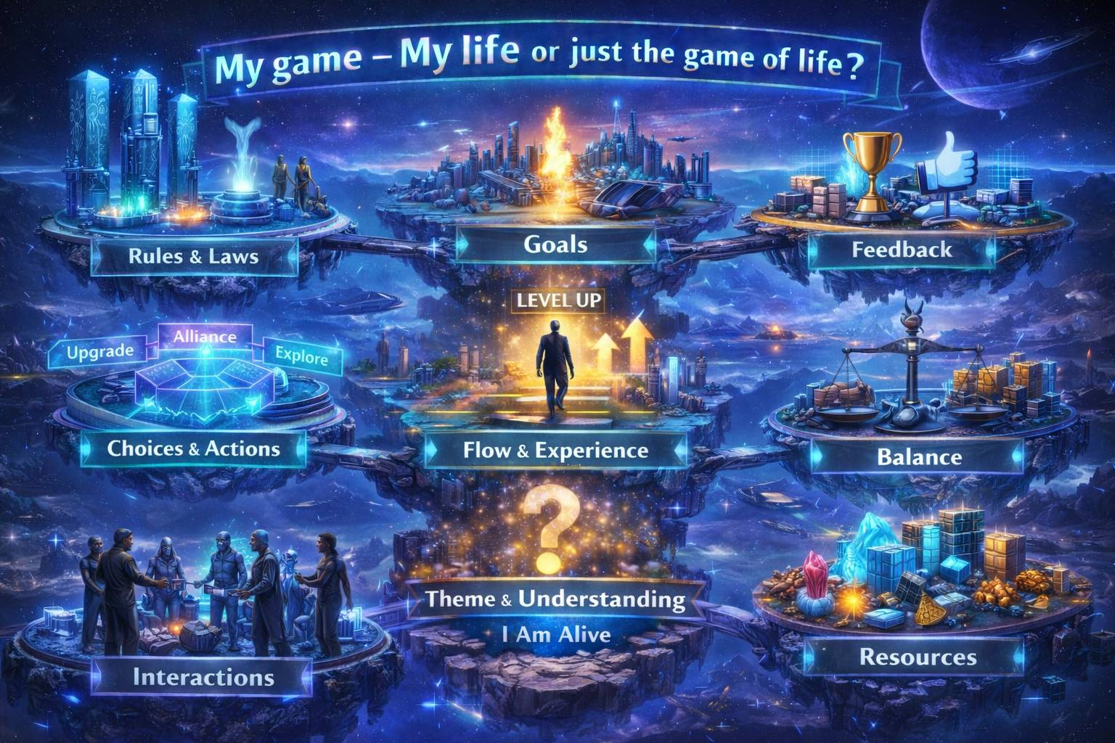

Slide 20
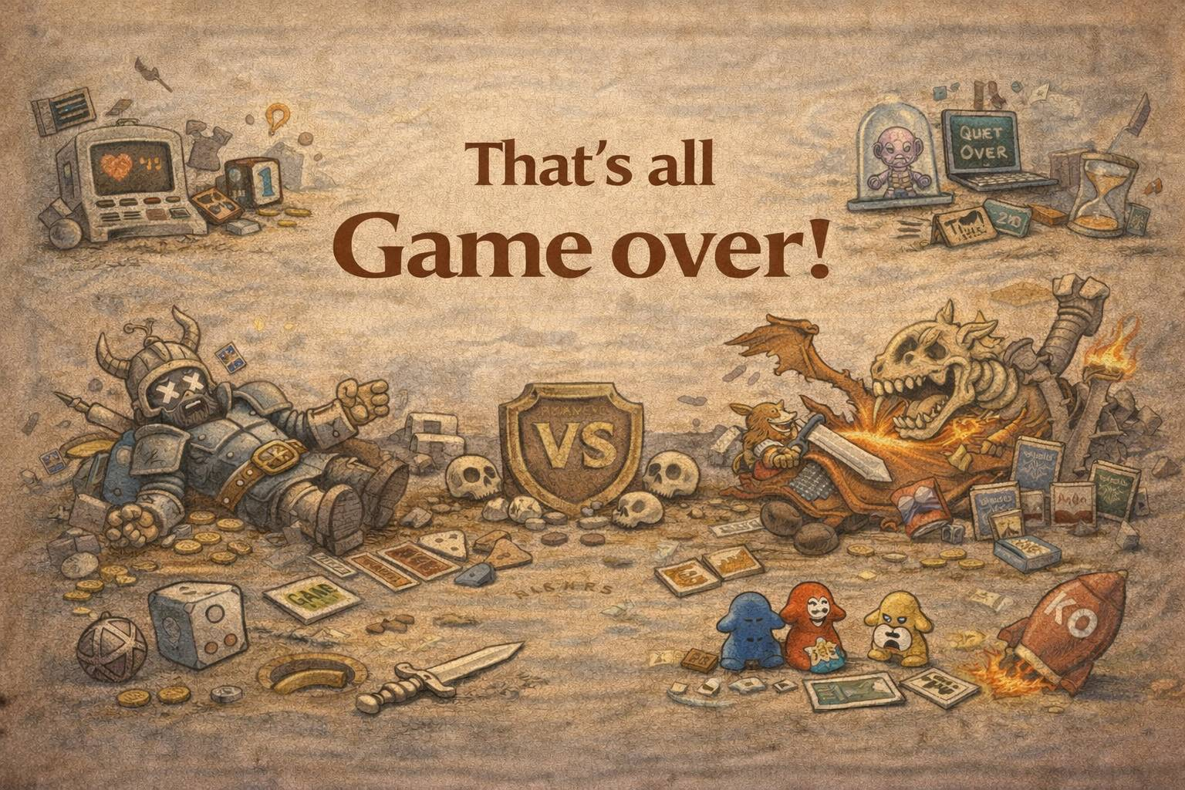

Slide 21
The following slides are the same just with text

Slide 22
What is a board game? – 9 game design fundamentals
  Rules – Frameworks that create opportunities and define limitations for achieving the goal
  Choices/actions – meaningful decisions – consequences
  Goals – what players are trying to achieve
  Feedback (feedbacklop – The game tells you how it's going (feedback for the decisions made (you get something)
  Interaction/– how players influence each other (conflicts/trading/cooperating )
  Flow and experience/game state – the feeling the game gives (especially progress) how the game changes over time while playing
  Balance – no strategy must dominate. Achieved during different game mechanism (some main mechanism are explained later
  Theme and understanding – what ties everything together in a meaningful context
  Resources/power – Things/elements players can control, lose, or gain (helping to achive the overall goal of the game

Slide 23
1. The rules (constraints) – the game laws
The game core element
Rules are limitations that create creativity and strategy.
Well-designed rules are:
  simple (well-supported by illustrations and icons and that make it easy to understand and overview)
  Explain the goal and game mechanism
  Give players meaningful choices (and consequences) connected to actions
  Can be explained in a relatively short time to get started (can be complicated over time, expansions etc)
  Good short clear examples (much easier now with help from AI)
Bad rules:
  are long and boring to read
  is contradictory
  Hard to understand the real meaning
  or limit the players with no interesting choices

Slide 24
2. Player-Driven Choices (part of the rules)
The core of any board game is the choice of actions that lead to the goal.
A good choice is:
  meaningful and a part of the way to achieve the goal (have consequences)
  interesting (weighed against risk and consequences)
  agency (Player feels in control of the outcome!)
  understandable (the players understand the effect and consequences of the choice instead of guessing)
  non-deterministic (no "perfect strategy", as in Matador/monopoly
Without choices, the game is an activity, not a game.

Slide 25
🎯 3. Goal of the game
A game must have a goal that the players must achieve (direction) winning the game – ending the game
The goal (or goals) defines how to win/finish the game and must be:
  Clear
  Measurable
  Motivating
Examples:
  First to 10 points (victory points) - Settlers/Catan
  Eliminate the opponents - Risk
  Build a network or a construction - Carcassone
  Survive a number of game rounds- Pandemic
  Largest wealth, most resources/items Monopoly, Powergrid
  Fulfill contracts (number of contracts or points from contrcts) Concordia, Ticket to ride
  Not all games have an ending (similation game – avoiding the game end (Sims board game)

Slide 26
4. Clear feedback (feedback-loops)
  The game should constantly show each player:
    How it goes(progress)
    What worked
    How actions affect the state of the game
    Feedback can be:
      Points, resources gained/lost, power etc.
      Cards drawn
      A game board that changes
      Change of rules or adding new rules
      Opponents' reactions
    Feedback creates learning, excitement and flow.

Slide 27
5. Interaction between players
Board games vary greatly in the way that players interact:
  High interaction confrontational (Risk)
  High interaction collaboration (Pandemic, Exit)
  Indirect/limited interaction(Carcassonne, Splendor)
  Limited to a few opponents(7 wonders)
  Divided into own game (build your world on your own board) and joint play (common game board) (Isle of Sky and Village)
  No interaction (Solitaire Games – Player against the game
  The choice of form of interaction defines the social dynamics of the game.

Slide 28
6. Progression and flow
The game should feel like a journey and have a good flow.
Typical flow models:
  Slow start → stronger powers → climax
  Steady momentum → sudden spikes
  The pressure increases towards the end
Flow must never be:
  Too slow
  Too monotonous
  too complex too early
Good flow makes for a good story.

Slide 29
7. Balance – a fundamental game design principle
No strategy must be objectively best
The balance can come from:
  non-transitive loops (Rock-Scissor-Paper – the basic mechanism in many games)
    It goes in circles (r beats, s beat p and p beats R), transitively, where a>b and b>c is a>c
  Randomization (dice, draw cards, spinning wheel etc.)
  Player interaction (trade, auction, conflicts)
  Asymmetry (balance through diversity in assumptions)
  Strategy - Resource structures
    Scarce resources (to be prioritized)
    Trade-offs (opportunity cost) (Using one resource reduces another opportunity)
    Conversion structures (resources can be converted, but with loss or friction
    Bottlenecks – (One resource is the limiting factor (few construction sites etc.)
    Progression balance (Players with fewer resources get cheaper actions or more bonus, increasing costs during game, limited scalability
    Multidimensional balance = several resources (combining resources, focusing on one dimension, often loses strength in another.
    Psychological balance (Players feel in control, Mistakes feel self-chosen, Risk feels fair
Unbalanced games = bad games — unless the imbalance is deliberate and fun (Mad, Munskin)

Slide 30
8. Theme and mechanics
Theme makes the game intuitive.
A good theme:
  Explains the rules naturally
  Makes the game easier to learn
  Provides emotional connection
  Helps players understand actions
A bad theme:
  Feels sticky on
  Explains nothing
  Creates cognitive confusion

Slide 31
Examples of game mechanisms
Turn Taking
  Players take turns performing actions following a fixed structure.
Worker Placement
  Players place limited workers on action tiles to perform exclusive actions.
Deck Building
  Players continuously build their own deck, which improves their options over time.
Tile Placement
  Players place pieces/tiles in a common area to build structure, patterns, or scoring areas.
Area Control
  Players compete to have majority or dominance in certain areas.
Push-your-luck
  Players choose between stopping safely or continuing for bigger wins with the risk of loss.
Set Collection
  Players collect certain combinations of items to earn points or bonuses.
Asymmetry
  Players start with different abilities, goals, or rules that change their strategic options.
Resource Management
  Players manage scarce resources to optimize their path to victory.
Racing / Movement
  Players move towards a goal where pace and timing determine the winner.

Slide 32
Resources
Resources/power are all the elements that players can control, build, lose or convert, bringing them closer to the game's victory criterion.
  Physical (money, wood, stone)
  Abstract (time, actions, influence, power)
  Positional (control over areas)
  Informational (card in hand, hidden knowledge)
Resources are the engine of the game's decisions. - Without scarcity, → no real choices.
  Scarcity → prioritization
  Trade-offs → strategic choices
  Conversion → progression
  Risk → tension
  Interaction → conflict or cooperation
What characterizes a good resource design?
  Scarcity is balanced (neither too abundant nor too tight)
  More ways to turn resources into victory
  No dominant strategy
  Resources are directly linked to the victory criterion
  Players can influence each other's access to resources

Slide 33
Summing up - Elements of a good game
Goals and limitations – so a good game has
  A clear goal (win, escape, build something, survive, etc.)
  Rules that set the framework and create challenge
  It is precisely the balance between goals and limitations that makes:
    The task difficult, but not too difficult
    The choices interesting
    Strategies possible
    Limitations drive creativity and strategy.
The experience should be worth coming back to as ety good game
  is not just mechanics – it's a feeling:
  Excitement
  Cooperation and/or conflict
  Coping
  Humor
  Imagination
  Competition

Slide 34
My game – My life or just the game of life?
Understanding the life – why I am doing this and this in my life:
  Rules – Laws, ethic, behavior (different depending on the context)
  Choices/actions – meaningful decisions (all what I am doing every day for achieving my goals
  Goals – what I am trying to achieve in my life (power, money, house – fulfilling Maslows need pyramid
  Feedback (feedbacklop – my experience, tells me how it's going (feedback for the decisions I made like receiving awards, money, increasing power etc)
  Interaction/– how I behave together with other people during conflicts/trading/cooperating, helping )
  Flow and experience – the feeling the life gives (especially progress and results reaching sub goals)
  Balance – complex (not my focus, but important for the society (goverments try to make conditions fair as long you are following the rules
  Theme and understanding – what ties everything together in a meaningful context – I am alive
  Resouces – All the things I really want and fighting for (winning my game of life

Slide 35
Not mention during the presentation

Slide 36
8. Components and physical design
Board games are tangible systems.
Component quality affects:
  Understanding
  Pace of play
  Experience

Slide 37
10. Playtesting
A game is not finished until it has been tested...
Playtesting reveals:
  imbalances
  dead rounds
  Incomprehensible rules
  Boring choices
  for long games
The best designers remove more than they add (save them for an expansion

Slide 38
Game Design Fundamentals
Game Mechanics/ game engine
  Turn taking
  Worker placement
  Deck building
  Tile placement
  Area control
  Push-your-luck
  Set collection
  Asymmetry
  Resource management
  Racing / Movement

Slide 39
Spil-kategorier
(måder spil opfører sig eller føles på) - Hvad spillerne gør
🎯 Conflict / Battle
    Players try to reduce opponents, win duels, or dominate.
🤝 Cooperation
    Players work together against a common threat.
📦 Resource Management
    Players are balancing scarce resources.
🧠 Social / Bluff
    Players fool each other, read intentions, use psychology.
🏃 Racing / Movement
    Players move towards a goal or through a space.
🏗️ Worker Placement
    Players place tiles to lock actions.
🎲 Dice-based
    Games use dice for outcomes.
🎚 Variable Player Powers
    Players have unique abilities (asymmetry)

Slide 40
Spilmekanismer og Oversigt over kategorier
Brætspilskategorier
Familiespil
Børnespil
Brætspil med kort
Klassiske brætspil
Spil for to
Selskabsspil
Eventyr- og rollespil
Samarbejdsspil
Strategispil
Quiz spil
Escape Room-spil
Brætspils mekanikker
Area Control
Auction/Bidding
Campaign/Legacy
Card Drafting
Deckbuilding
Dice Rolling
Dungeon-crawler
Grid Movement
Hand Management
Modular Board
Pattern Building
Player Elimination
Press/Push Your Luck
Role playing
Set Collection
Social Deduction
Storytelling
Take That
Tile Placement
Variable Phase Order/Player Powers
Worker placement

